Slide 1


Customer Shopping Behavior Analysis
Uncovering insights from 3,900 purchases to guide strategic business decisions
Notes:
1

Slide 2
Dataset Overview
3,900
18
37
Transactions Analyzed
Data Fields
Missing Values
Purchase data across diverse product categories
Comprehensive customer and purchase details
Addressed in Review Rating column
Key Features
Missing Data
Customer demographics (Age, Gender, Location)
Purchase details (Category, Amount, Season)
Shopping behavior (Discounts, Frequency, Ratings)
37 values in Review Rating column imputed using median ratings by product category.
Notes:
2

Slide 3
Data Preparation Process
01
02
03
Data Loading
Missing Data Handling
Column Standardization
Imported dataset using pandas with initial exploration via df.info() and describe()
Imputed 37 missing review ratings using median by product category
Rewrote columns to snake case for better readability
04
05
Feature Engineering
Database Integration
Created age_group and purchase_frequency_days columns
Connected to PostgreSQL and loaded cleaned DataFrame
Notes:
3

Slide 4


SQL Analysis: Revenue Insights
Revenue by Gender
Shipping Comparison
Male customers generated $157,890 vs. Female customers at $75,191
Express shipping: $60.48 average vs. Standard: $58.46
Notes:
4

Slide 5



Product Performance
Top Rated
Most Discounted
Best Sellers
Gloves (3.86), Sandals (3.84), Boots (3.82)
Hat (50%), Sneakers (49.66%), Coat (49.07%)
Blouse, Pants, Jewelry, Sunglasses (171 orders each)
Notes:
5

Slide 6



Subscription & Customer Segments
27%
80%
18%
Subscribers
Loyal Customers
Returning
1,053 customers with subscription
3,116 customers in loyal segment
701 customers making repeat purchases
Revenue by Status
Repeat Buyers
Non-subscribers: $170,436 (2,847 customers)
958 repeat buyers (over 5 purchases) vs. 2,518 single-time buyers
Subscribers: $62,645 (1,053 customers)
Notes:
6

Slide 7
Age Group Analysis
26%
25%
Young Adult
Middle-aged
$62,143 revenue
$59,197 revenue
24%
24%
Adult
Senior
$55,978 revenue
$55,763 revenue
Young Adults drive the highest revenue at $62,143, followed by Middle-aged customers at $59,197
Notes:
7

Slide 8
Power BI Dashboard
Key KPIs
Interactive Filters
Visualizations
3,900 customers, $59.76 average purchase, 3.75 average rating
Subscription status, gender, category, shipping type
Donut charts, bar charts showing revenue and sales by category and age group
Notes:
8

Slide 9

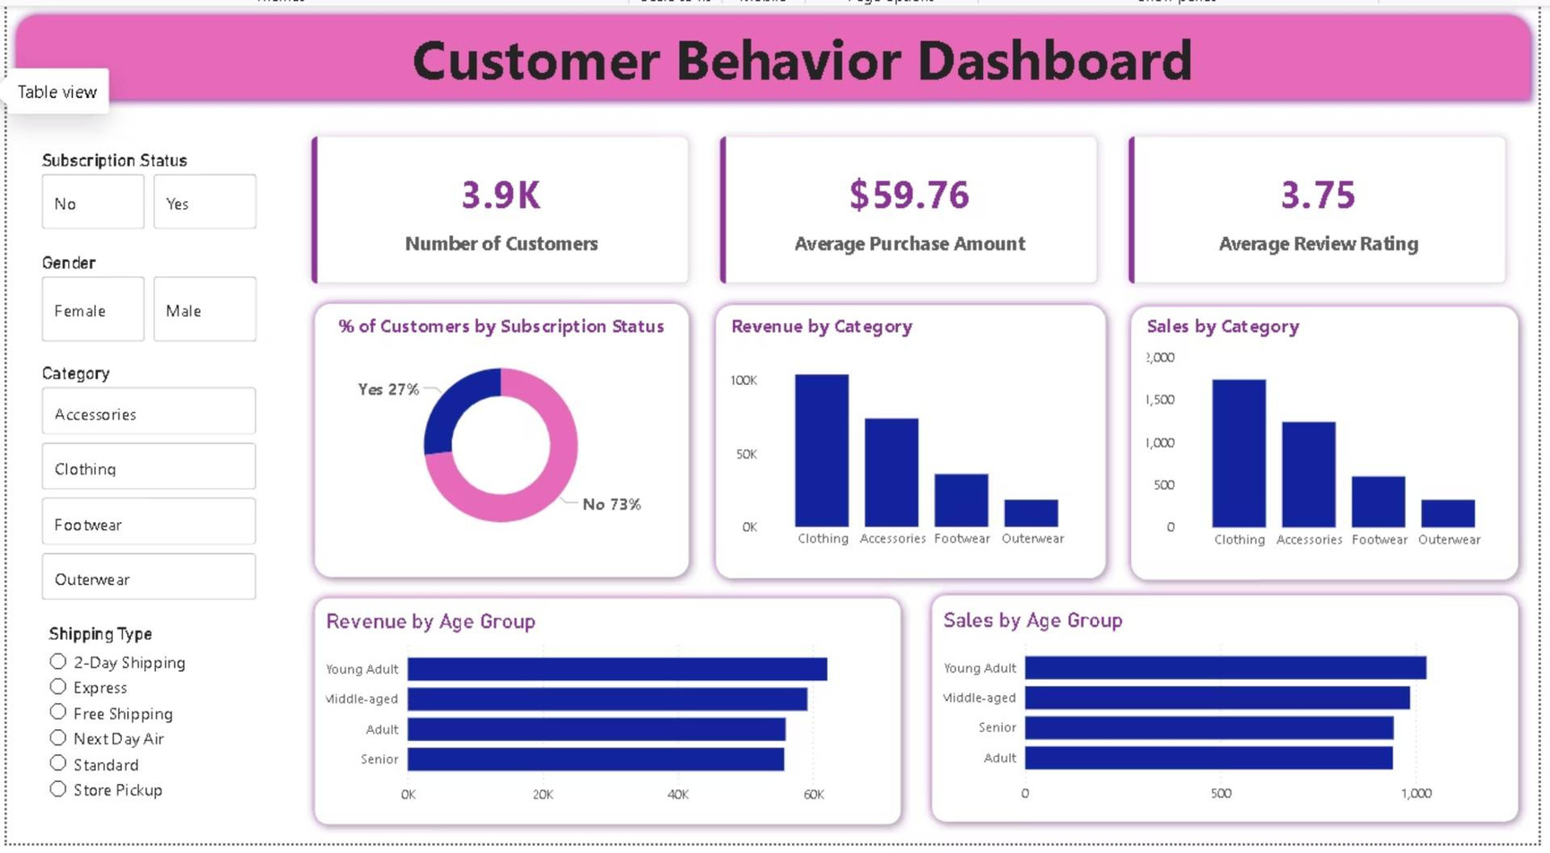
Notes:
9

Slide 10
Key Findings
Male customers spend 2.1x more than female customers
Express shipping customers spend $2 more on average
$157,890 vs. $75,191 in total revenue
$60.48 vs. $58.46 for standard shipping
80% of customers are loyal repeat buyers
Young adults drive highest revenue
$62,143 from young adult segment
3,116 loyal customers out of 3,900 total
Notes:
10

Slide 11




Strategic Recommendations
Boost Subscriptions
Enhance Loyalty Programs
Promote exclusive benefits to increase subscriber base from current 27%
Reward repeat buyers to accelerate movement into loyal customer segment
Optimize Discount Strategy
Target High-Value Segments
Balance sales boosts with margin control, especially for high-discount products
Focus marketing on young adults and express-shipping users
Notes:
11

